Slide 1
Research Progress Presentation - RAC I
By - Vvedika Jain M
2340171

Slide 2
Title of the Research Paper
Cloud-Integrated Acoustic Healthcare: Computational Frameworks, IoT, and Smart Data Management for Sound-Based Medical Systems

Slide 3
Problem Statement
The Challenge: Acoustic therapy is a proven, non-medicinal method for enhancing well-being which helping in stress relief, focus improvement, and pain management. However, traditional therapies lack personalization, data-driven insight, and scalability.
The Core Problem: There’s currently no scalable platform that integrates real-time health data with cloud infrastructure to deliver and manage acoustic healthcare in a smart, accessible, and adaptable way.
The Opportunity: With the rise of cloud computing and the Internet of Things (IoT), there is a growing opportunity to revolutionize how acoustic therapy is delivered and optimized.

Slide 4
Objectives
Primary Objective: To design and develop a cloud-integrated acoustic healthcare framework that leverages IoT-based real-time health data to deliver personalized and scalable acoustic therapy services.
Secondary Objectives
To collect and manage real-time physiological and user-generated data using IoT devices and cloud infrastructure for effective monitoring and analysis of acoustic therapy outcomes.
To evaluate the effectiveness and scalability of the proposed system in enhancing therapy personalization, accessibility, and user well-being compared to traditional acoustic therapy approaches.

Slide 5
Literature Review (Base Papers)
Title | Authors | Published in | Research Gaps
Automatic Emotion‑Based Music Classification for IoT Applications | Jin Seo and Jaehong Huh | Electronics, MDPI (2019) | Does not use cloud computing, real-time processing, or scalable infrastructure. Data personalization and storage are not addressed.
A Review of the Application of Acoustic Vibration for Therapeutic Use in Clinical and Home Settings |  | Electronics, MDPI (2019) | Discusses clinical benefits of acoustic vibration but does not address real-time data integration, cloud infrastructure, or personalization. Highlights the therapeutic value, creating a need for technology-enabled personalization and scalability.
IoT-Based Health Monitoring System for Active and Assisted Living |  | Sensors, MDPI (2020) | Strong IoT data capture and cloud integration techniques for health monitoring—but not applied to acoustic therapy. This exposes a domain-specific gap: acoustic therapy is not yet integrated into smart IoT/cloud-based health frameworks.
Development of Wearable Vibroacoustic Devices for Sleep and Stress Management |  | Sensors, MDPI (2022) | Describes device-level innovations, but lacks a system-level framework (cloud + IoT + data processing). Demonstrates demand for a centralized data-driven management platform that can aggregate, analyze, and personalize therapy sessions.

Slide 6
Research Methodology
1. Literature Review
Reviewed existing work on:
Acoustic & vibroacoustic therapy
IoT-based health monitoring
Cloud computing in healthcare → Built the scientific and technological foundation.
2. Gap Identification
Identified limitations in current acoustic therapy:
No personalization
No real-time data
No cloud scalability
Limited remote monitoring → Defined the research problem.

Slide 7
3. Conceptual System Design
Outlined a high-level framework using:
Sensors & wearables
Python-based processing
IoT communication
Cloud platforms (AWS/GCP) → Forms the core architecture of the proposed system.
4. Technology Exploration
Explored role of:
Python → processing & analytics
IoT → continuous data capture
Cloud → storage, scalability, ML
Wearables → physiological signal tracking
5. Comparative Analysis
Analyzed existing solutions and trends:
Brain.fm, Endel, Moodsonic
Smart hospitals & global adoption → Validates the need for a tech-enabled acoustic therapy system.

Slide 8
Overview of our Research and Progress
Introduction to Acoustic Healthcare (Completed):
Acoustic therapy uses sound waves for non-invasive healing, relaxation, and pain relief.
Blends ancient traditions with modern science.
Historical & Traditional Roots (Completed):
Ancient civilizations (Egypt, Greece, India, Tibet, Indigenous cultures) used sound for healing rituals and emotional influence.
Scientific Foundations & Modern Evolution (Completed):
Early 20th century: Scientific exploration began with ultrasound technology.
Mid 20th century: Explored neurological impact (e.g., binaural beats for brainwave modulation).
Recent decades: Expanded to low-frequency sound, vibroacoustic, music therapy, and frequency-specific microcurrent therapy.

Slide 9
Benefits of Sound-Based Healing (Partially Completed) :
Physiological: Pain management, tissue regeneration, inflammation reduction, improved circulation, muscle relaxation.
Psychological/Emotional: Stress/anxiety reduction, mood enhancement, improved sleep quality, cognitive/neurological benefits.
Role of Technology in Enhancing Acoustic Healthcare (In Progress) :
Wearable Devices: Portable vibroacoustic systems (e.g., Resonate Pillow, Sound Oasis VTS-1000).
AI-Driven Platforms: Personalized soundscapes based on biometrics (e.g., Brain.fm, Endel).
Clinical Systems: Therapeutic ultrasound for targeted healing (e.g., Exogen, Zetroz sam®).
VR & Sound Integration: Immersive environments for relaxation (e.g., HealiumXR).
Neuroacoustic Feedback: EEG-based systems for brainwave modulation (e.g., NeuroVizr).
Smartphone Apps: Accessible sound therapies (e.g., Tinnibot, Calm, Melomind).
IoT-Enabled Beds: Real-time biometric-responsive sound modulation (e.g., Sleep Number 360 Smart Bed).

Slide 10
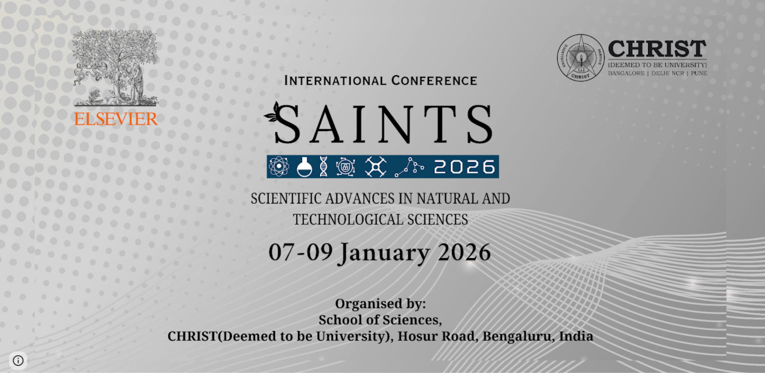
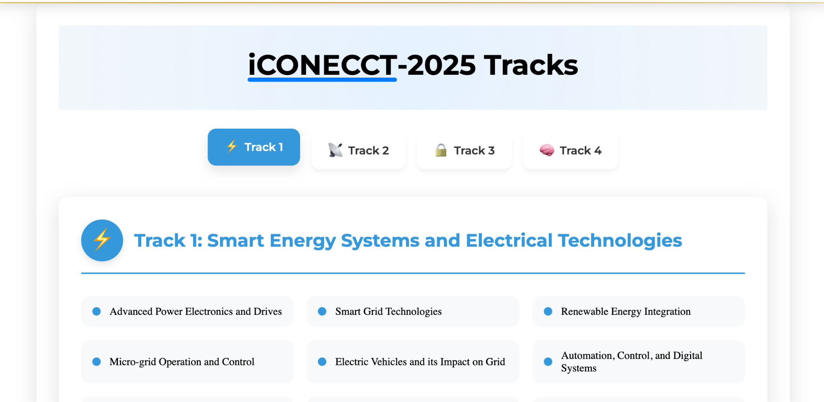
Conference Targets

Slide 11
Thank you

